Slide 1
Optometry First in Action
Isle of Wight March 2023

Slide 2
Optometry First on the Isle of Wight
Optometry 1st – a comprehensive new care model fully utilising Primary Care Optometry in the delivery of first contact care to resolution and continuity of care for people with a long-term eye condition, working in partnership with the hospital eye service.
Local Context –
The number of people aged over 65 is increasing across the whole of England,
Locally this trajectory is being accelerated through a reduction in younger people as people leave to access higher education / careers, as well as inward migration of those aged 60-74 years.
Mid-2018, 27.76% of the Island population was aged 65 and over.
An additional 24.5% of people will be aged 65-84 years and a further 31.8% of those aged 85+ are projected by 2030.
Out of hours HES support by UHS and PHU
Pre-Pilot Pathway State (Q4 2022) –
Ophthalmic surgical intervention, monitoring and follow-up care delivered by Hospital Eye Service
Eye emergencies / out of hours care by Emergency Department
Local Challenges –
Higher prevalence of age-related ophthalmological conditions
Drive for financial and workforce sustainability
Geographically isolated boundary
High demand with lengthened waiting lists compacted by the impact of the pandemic
Restricted workforce capacity in traditional model
Urgent Referrals
Community optometrists providing routine sight tests and some participating in the Covid Urgent Eyecare Service (8 practices)
Routine Referrals
GPs

Slide 3
Pilot Implementation 2022/23
Nov 20
Covid Urgent Eyecare Service implemented on the Isle of Wight by Primary Eyecare Services in response to the Covid-19 pandemic. Based upon the nationally developed model by NHS England, LOCSU and the Clinical Council for Eye Health Commissioning and clinically endorsed by the Royal college of Ophthalmologists and College of Optometrists.
Feb 22
Isle of Wight was successfully selected as one of three Early Adopter sites for Optometry First in England as part of the National Eye Care Recovery and Transformation Programme (NECRTP) led by NHS England and NHS Improvement.
Apr 22
Isle of Wight Optometry First project group commences. Covid-19 Urgent Eyecare Services updated to Community Urgent Eyecare Service (CUES).
Jul 22
Phase 1 OPERA / MediSight interface complete. Pre-cataract referral pathway commences.
Oct 22
Phase 2 OPERA / MediSight interface complete. Post-cataract referral pathway commences.
Feb 22
Implementation of single point of contact / telemedicine for CUES pathway.

Slide 4
CUES Activity
2022/23 Discharge Destinations
747 outcomes recorded FYE
702 outcomes recorded Q1-Q3
During pilot 22/23 there has been a steady increase in utilisation of the CUES service
60% increase from Q1 to Q2
65% increase from Q2 to Q3
If Q3 levels sustained, projected activity 1056 episodes of care – a 41% increase on the previous year.
22/23 YTD 65% patients self-refer, 20% access via 111
96% receive an initial assessment within 4 hours

Slide 5
Impact on HES Referrals
Start of Covid-19 restrictions
Start of Covid Urgent Eyecare Service
Final Covid-19 restrictions lifted
Optometry First Pilot
Referral activity has displayed expected dips during height of pandemic waves with no extreme surge seen from people not accessing care
During the 22/23 pilot and expansion to full Community Urgent Eyecare Service, decreasing referral trend into HES
22/23 ED activity 71% of pre-pandemic level – a decrease of 178 appointments
22/23 now more urgent (appropriate) cases (53% compared to 45% 19/20)
Other referral sources are now predominantly routine referral (64% 22/23 vs 26% 19/20) suggesting cases are being managed in the community and conditions are being picked up earlier before escalation.
Year | Referrals from ED |  |  |  | Other referral sources |  |  |  | All Activity
 | Total | Urgent | Routine | Routine % of Total | Total | Urgent | Routine | Routine % of Total | All Activity
2019/20 | 101 | 45 | 56 | 55% | 841 | 623 | 218 | 26% | 942
2020/21 | 92 | 50 | 42 | 46% | 795 | 244 | 551 | 69% | 887
2021/22 | 74 | 38 | 36 | 49% | 804 | 249 | 555 | 69% | 878
2022/23 | 72 | 38 | 34 | 47% | 692 | 250 | 442 | 64% | 764

Slide 6
Pre-Cataract Pathway
Data suppressed as <5
Referrals via a community pre-cataract pathway was commenced on 25 July 2022.
Between August 2022 and February 2023 there were 90 referrals.
The largest PCN cohort was from South Wight (46%). This rate is slightly higher than the proportion of 65+ residents for the Island (32%).
Data suppressed as <5

Slide 7
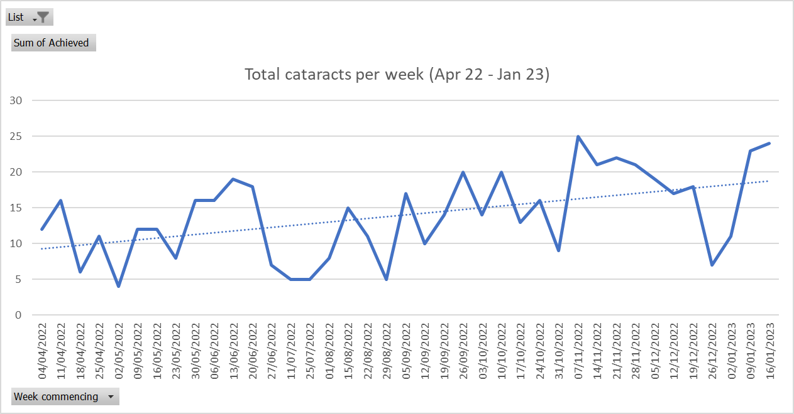
Post-Cataract Pathway
Post-Cataract Pathway Live PLUS HFLC Project
Trust data suppressed as <5
Post-Cataract Interim Support
Data suppressed as <5
Source: MHS & local clinic data
Post-cataract interface between OPERA and MediSight complete 31st October and pathway fully live.
High Flow Low Complexity theatre list project undertaken by Trust during Q3 to increase average procedure lists to GIRFT training standard of 8 per list.
Pre-January 2023, (6.5%) of post-cataract activity originated from the NHS IWT. During January and February, 120 (80.5%) of activity originated in the local Trust (light blue columns).
*Sources suppressed due to some figures being <5

Slide 8
2023 / 2024
What we’ve seen so far…
A thorough and very professional examination with a full and clear explanation and advice on treatment.
HIOW CUES feedback Q3 22/23
Value for money – increased efficiency through reduction in ED attendances and outpatient appointments
Patient experience – positive patient feedback regarding quality of care received and access. HES able to redirect capacity to address other pathways and waiting list, improving other patients’ care indirectly.
Improving workforce resilience – utilisation of existing resources more creatively and on integrated pathways increases pathway resilience and addresses traditional recruitment barriers.
Managing demand – HES able to redirect resources to focus on restoration and recovery of services post-pandemic.
Next Steps–
Continuation of existing service (CUES / Integrated Cataract pathway into 23/24
Development of an integrated glaucoma pathway
Exploration of improved Advice & Guidance capability between optometrists and HES

