Slide 1
EeRS Optical Practice Onboarding Step by Step Guide
For additional support contact:
Nicola Lakin (Derbyshire EeRS Project Manager)
Nicola.lakin@nhs.net
07799 637789

Slide 2
Data Protection Agreement/Protocol (DPA/DPP)
0. Non-Franchise Multiples – The DPP/DPA maybe completed by your HQ, therefore you can skip this step. Cinapsis will be in touch if this is not the case.
All other practices:
Access your Data Protection Protocol/Agreement document
Review the document and digitally sign
This can be signed by your Caldicott Guardian or Practice Manager
Save a copy of the signed version to your computer
Please note: You will be asked to upload this document as part of the onboarding process (see step 20/slide 12).

Slide 3
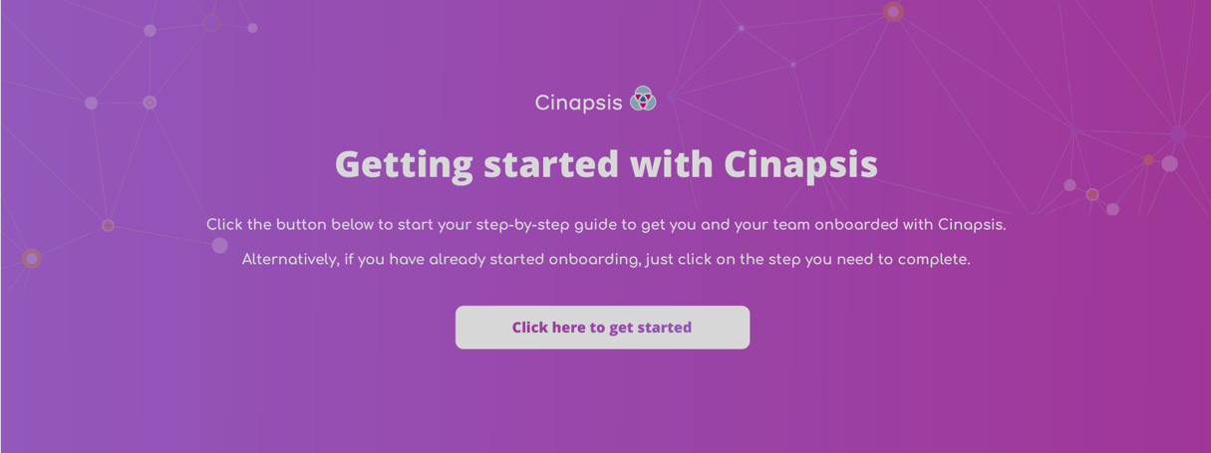
Cinapsis Registration of Interest Form (Registration of interest)
1. Click the Registration of interest link
This will open a web browser PDF
2. Click – Click her to get started

Slide 4
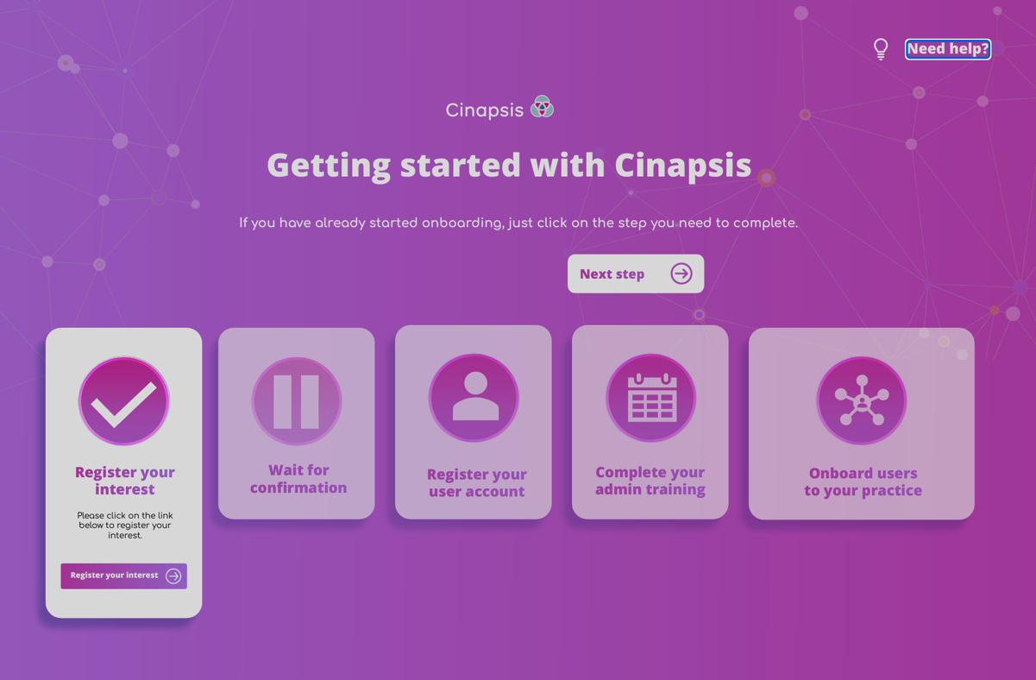
Onboarding Dashboard
This page illustrates your stage in the process of onboarding
For help access the Need Help? Icon in the top right corner to contact Cinapsis
3. Click Register your Interest to open the practice setup form
4. On the acknowledgement screen click Start

Slide 5
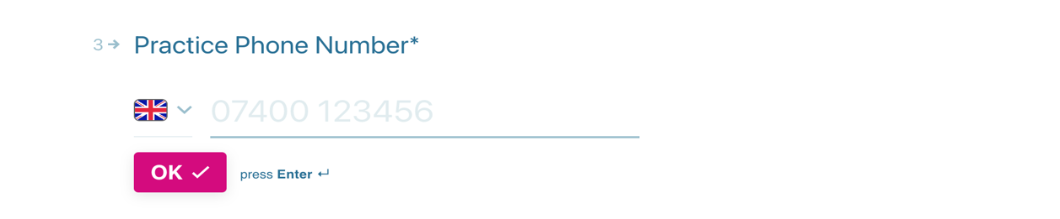
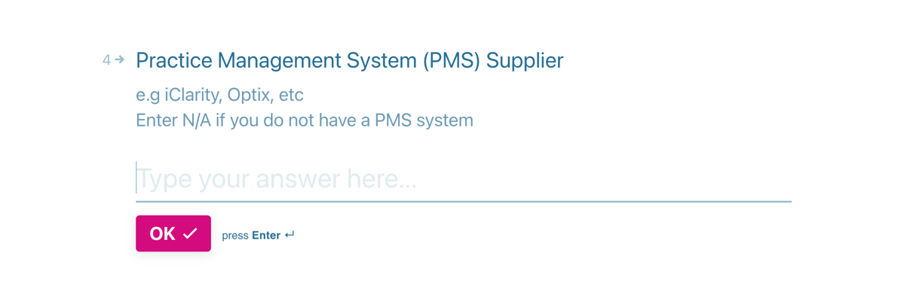
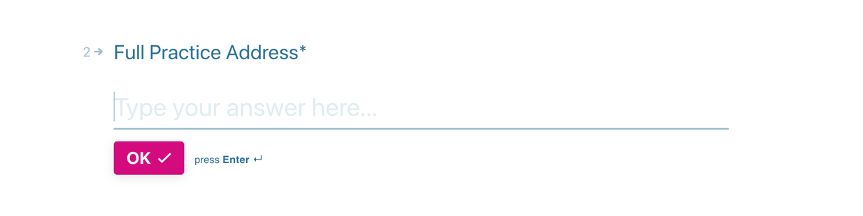
Practice Details (Qu. 1-4)
5. Type your Practice Name (this will help providers identify your practice), click OK
6. Type the practice’s full address, click OK
7. Type the practice’s telephone number, click OK
8. Add details of your Patient Management System (this is to support integration), click OK

Slide 6
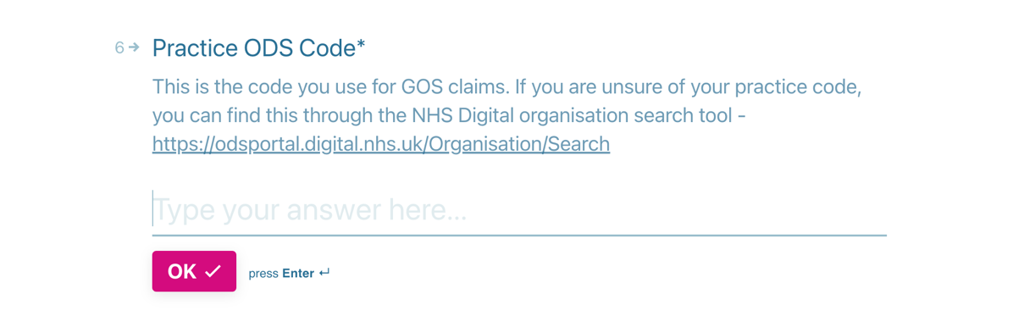
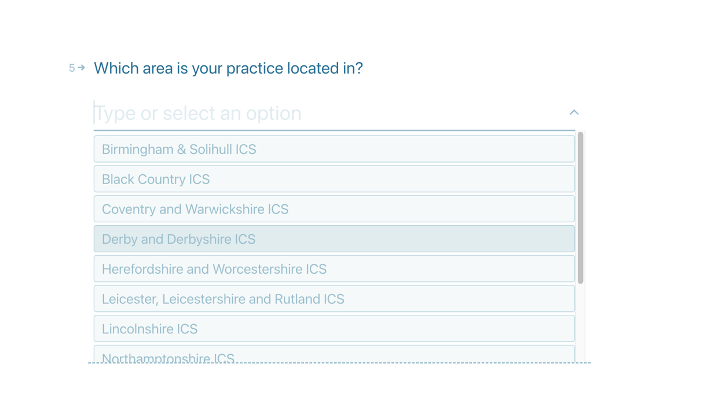
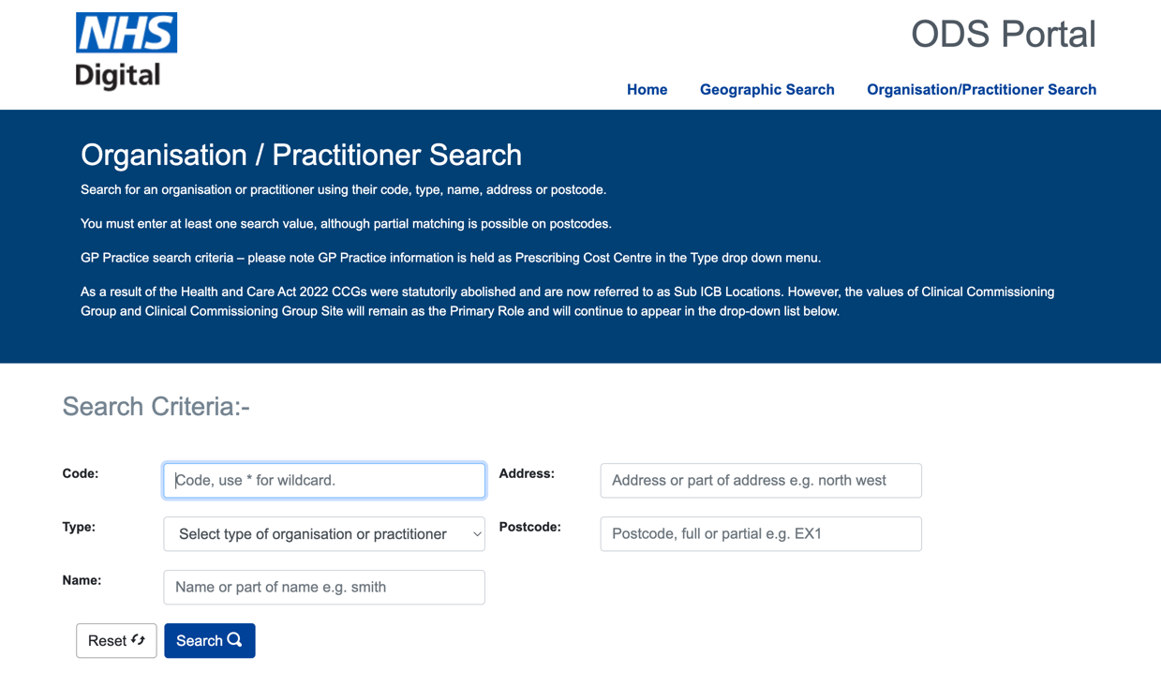
Practice Details – continued (Qu. 5+6)
10. Add your ODS Code, click OK
If unknown, your ODS code can be found:
https://odsportal.digital.nhs.uk/Organisation/Search
9. Select Derby and Derbyshire ICB from dropdown, click OK

Slide 7
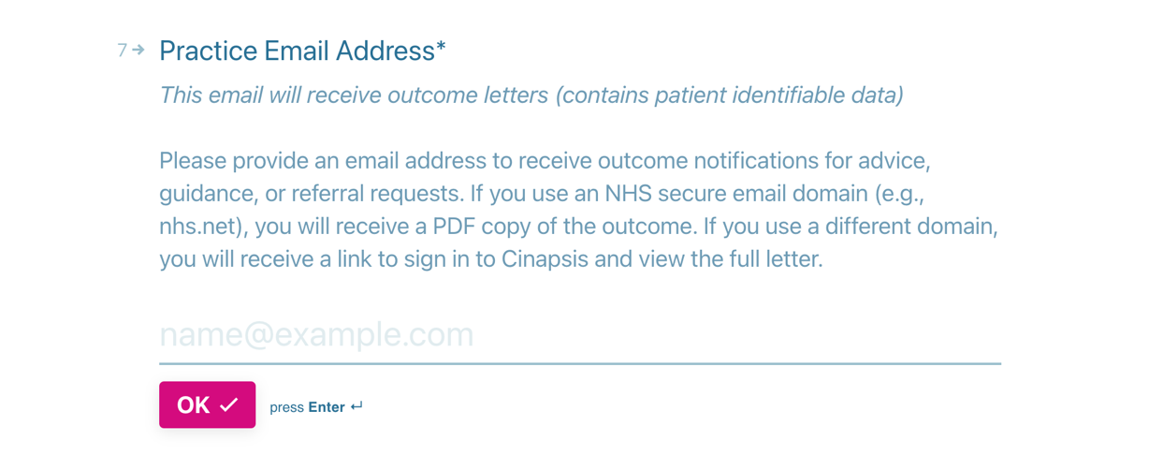
Practice Email Address (Qu. 7)
11. Add a generic/shared practice email address here, click OK
This email will be used to send referral responses for ALL referrals, therefore avoid using personal email addresses. If possible, use your shared NHS.net account to allow for PDF copies to be sent. If you do not have an NHS.net generic account, use any other shared mailbox, a link will be sent asking users to log into Cinapsis to access responses.

Slide 8
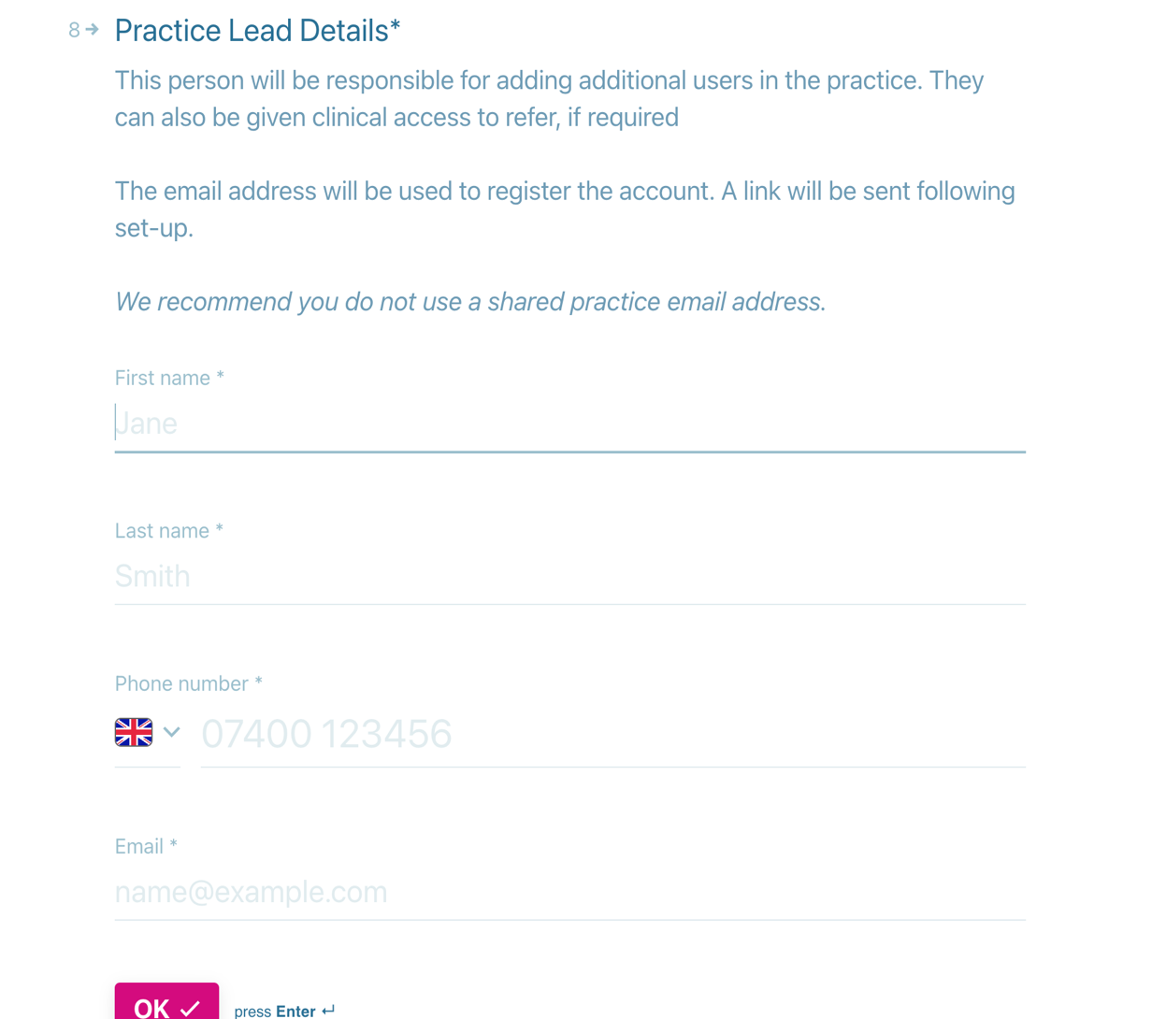
Practice Lead Details (Qu. 8) for personal user access
12. Type Your First Name,
13. Type Your Surname,
14. Type Your Telephone number,
Use your personal number as this will be used as an authenticator and for password resets.
15. Type Your Email address
Use your personal work email as this will be used as your login. Avoid using shared access emails. Ideally NHS.net where possible.
click OK

Slide 9
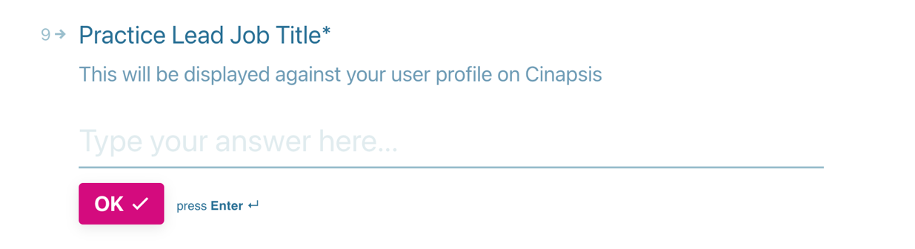
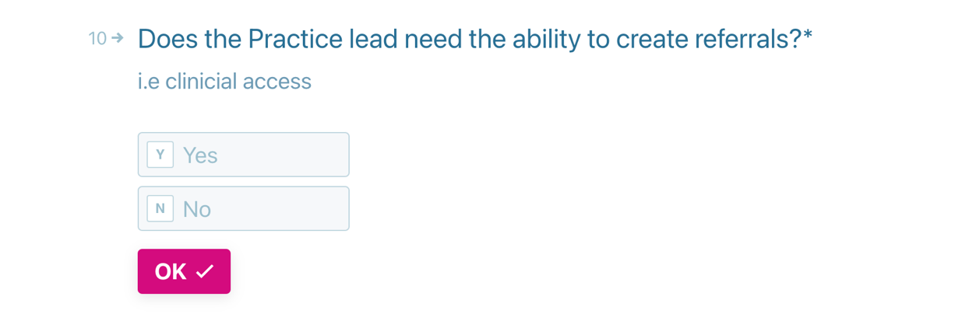
Practice Lead Details – continued (Qu. 9+10)
16. Type Your Job Description, click OK.
17. Confirm whether ‘you’ need access to send referrals, click OK.
Yes will give both admin and clinical access, No will only give admin access

Slide 10
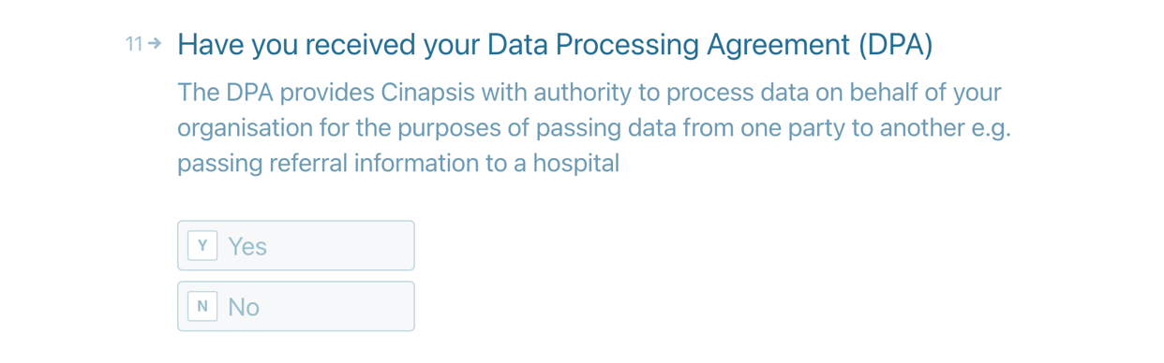
Data Protection Agreement/Protocol (DPA/DPP) (Qu.11)
18a. Non-Franchise Multiples – Select
No, Click OK
The DPP/DPA will be submitted by your
HQ - Jump to step 19
18b. All other independent practices – Select Yes, Click OK
Jump to Step 20
18c. Unsure? If you do not know whether your HQ is submitting your DPP or you are waiting for your Caldicott Guardian to review your agreement Select No, Click OK
Jump to step 19

Slide 11
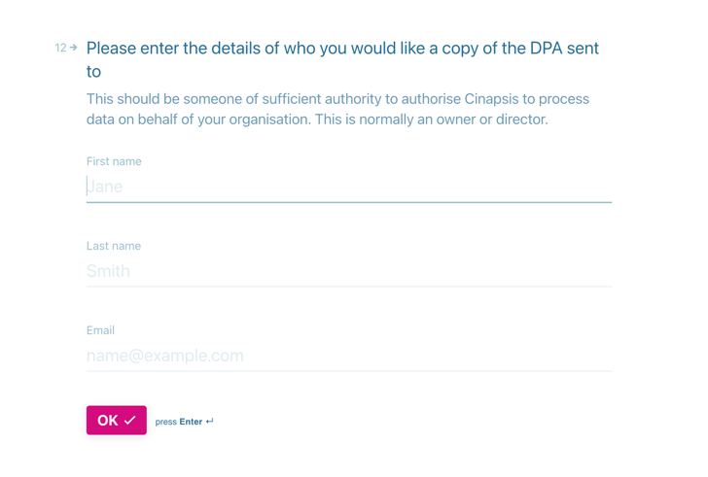
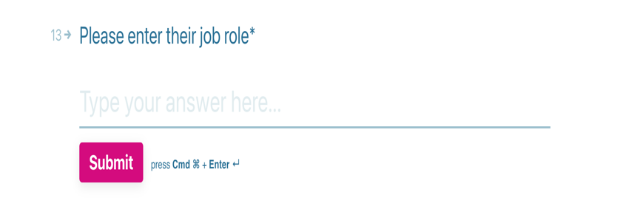
Data Protection Agreement/Protocol (DPA/DPP) – If NO
19a. Non-Franchise Multiples?
Q.12: Type N/A into the First name, last name, email fields, click OK
Q.13: Type HQ Company Name into Job Role field, click OK.
19c. Unsure or those waiting for signatures?
Q.12. Type N/A into the First name, last name, email fields, click OK
Q.13. Type N/A into Job Role field, click OK.
Waiting Signature - Please forward/chase DPP/DPA with any relevant colleagues for approval.
Unsure if needed – Contact Company HQ, LOC representative, or Nicola Lakin

Slide 12
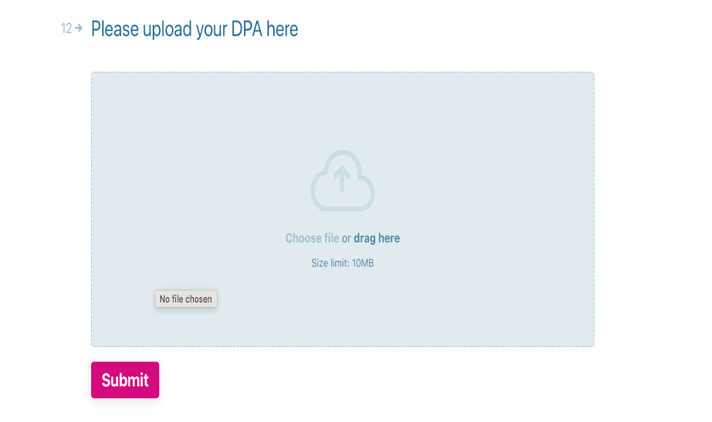
Data Protection Agreement/Protocol (DPA/DPP) – If Yes
20. Locate previously saved DPP/DPA document within File Explorer on your computer (as per step 0/slide 2).
Drag and Drop DPP/DPA file previously saved
Click Submit.

Slide 13
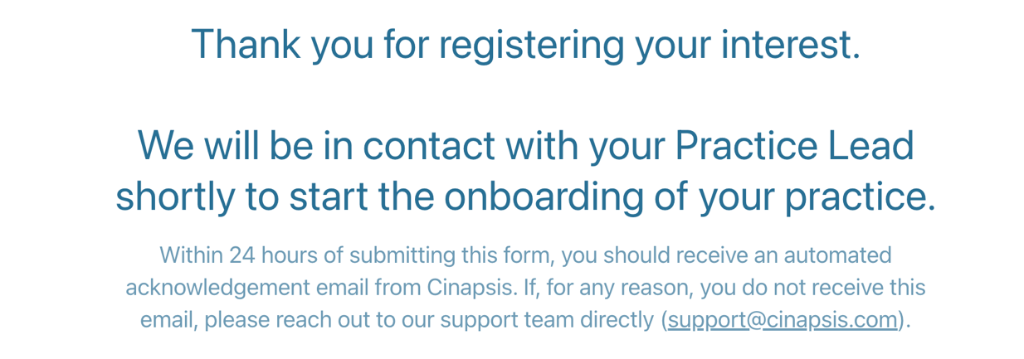
Confirmation of Registration of Interest - COMPLETE
21. Read confirmation, note support email (if needed) and close browser.
Please check for a confirmation email over next 24 hours,
Where DPP/DPAs have not been uploaded Cinapsis/EeRS Projects Team will chase if needed.
Please note practices will be in a pending state until DPP and DSPT are confirmed in preparation for Go-Live.

Slide 14
Nicola Lakin Derbyshire EeRS Project Manager nicola.lakin@nhs.net 07799 637789

