Slide 1
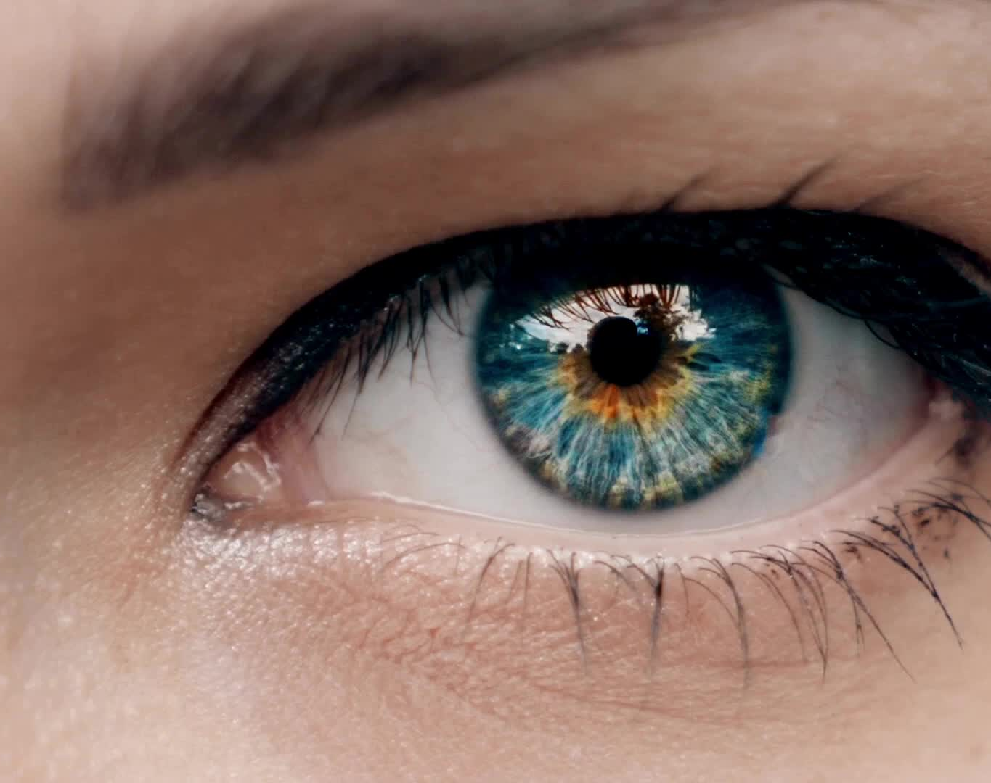
EYE CASUALTY REFERRALS MAKING AN EYE CASUALTY REFERRAL
OPTICAL PRACTICE INFORMATION PACK
PART TWO

Slide 2
MAKING AN EYE CASUALTY REFERRAL
Please follow the current process to create a referral. At the point where the pathway needs to be chosen:
Click on Eye Casualty – then choose either
Lincoln
Or
Boston
This will open the Eye Casualty Referral Form.

Slide 3
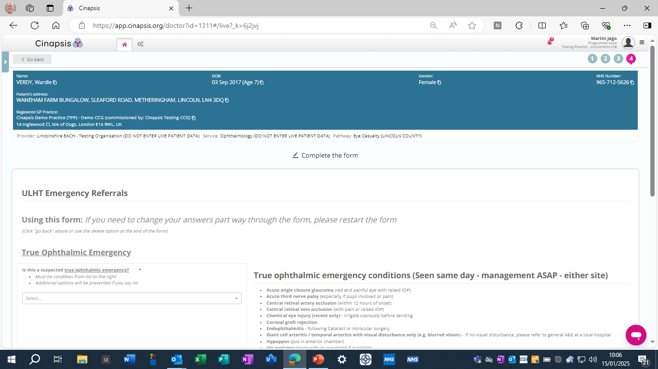
CHECK IF THE PRIORITY IS A TRUE OPHTHALMIC REFERRAL / SUSPECTED EMERGENCY REFERRAL / OPHTHALMIC EMERGENCY
CLICK ON SELECT

Slide 4
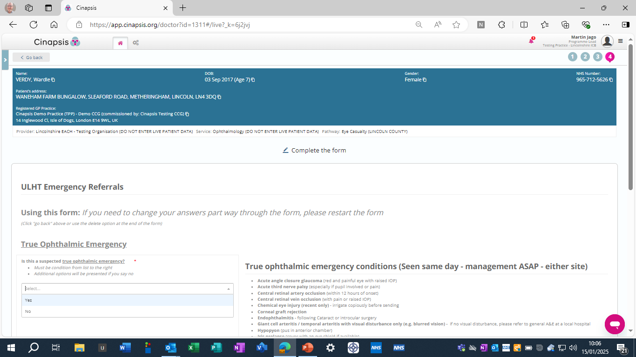
PLEASE CHOOSE YES OR NO:
YES - WILL OPEN THE REFERRAL FOR FURTHER INFORMATION
NO – WILL MOVE REFERRAL TO NEXT PRIORITY GROUP

Slide 5
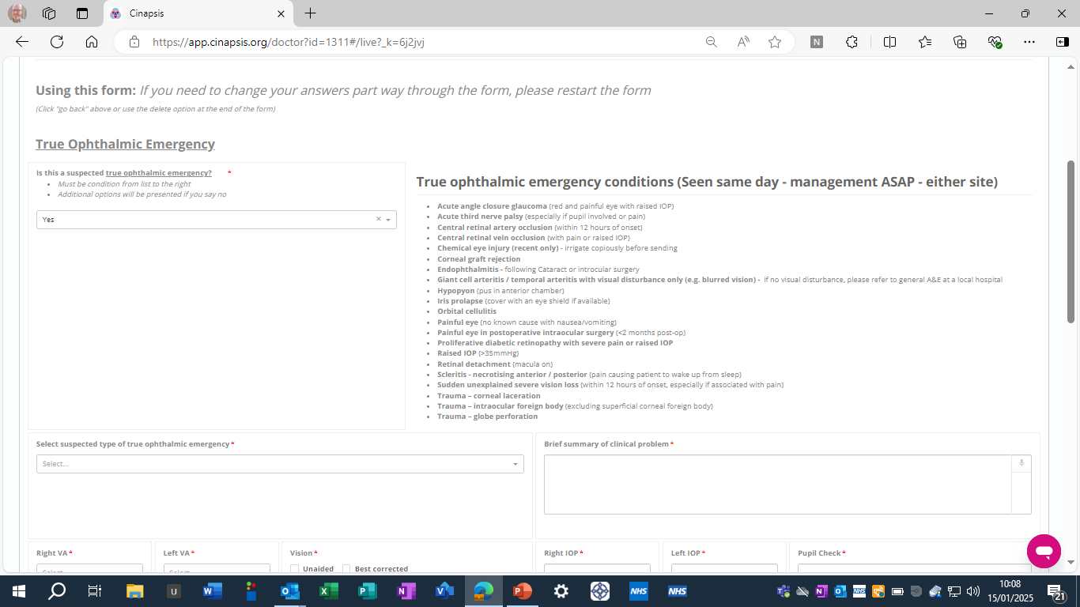
CLICK ON SELECT

Slide 6
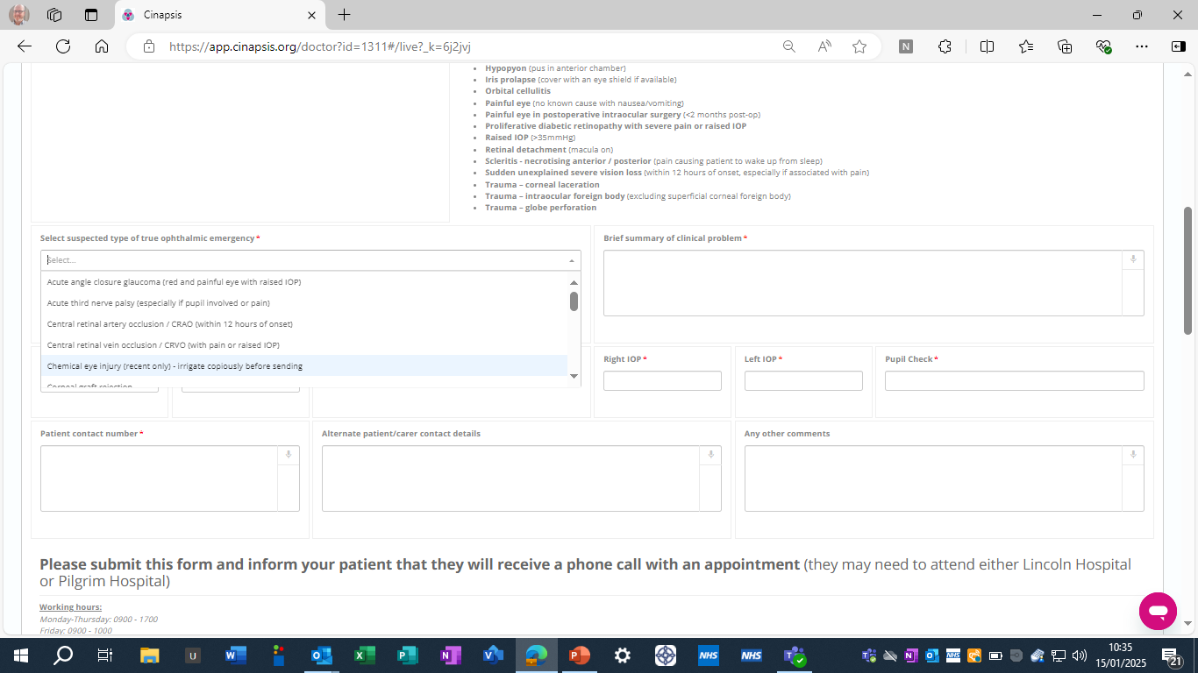
SELECT THE CONDITION BEING REFERRED

Slide 7
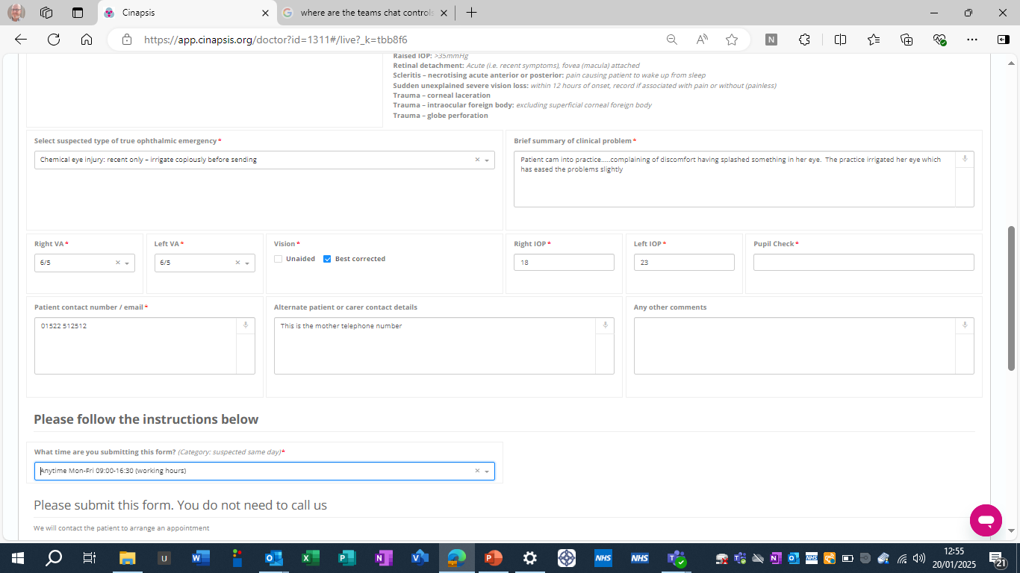
PLEASE COMPLETE ALL MANDATORY DATA FIELDS

Slide 8
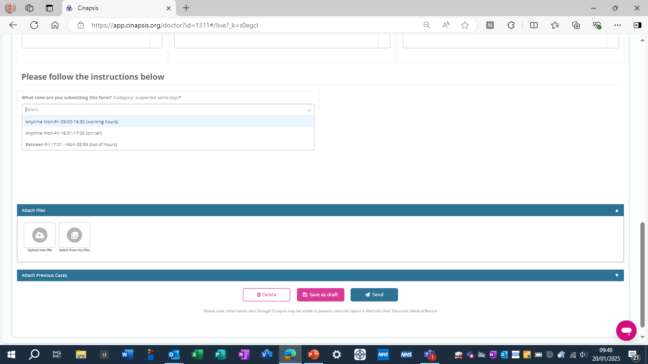
CLICK THE OPTIONS ARROW AND CHOOSE THE TIME YOU ARE MAKING THE REFERRAL

Slide 9
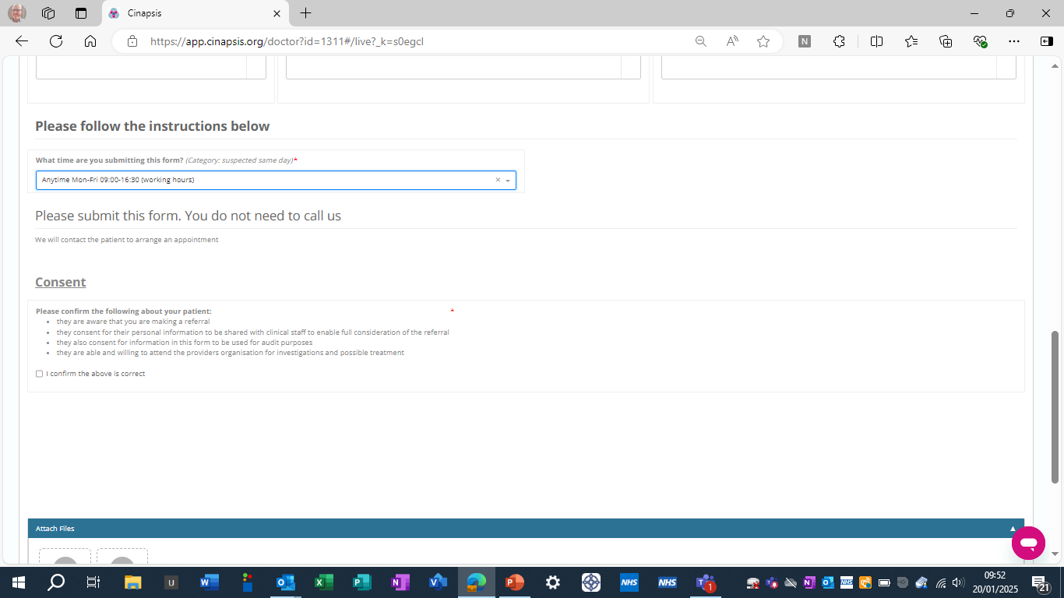
IF DURING EYE CASUALTY WORKING HOURS – YOU DO NOT NEED TO CALL

Slide 10
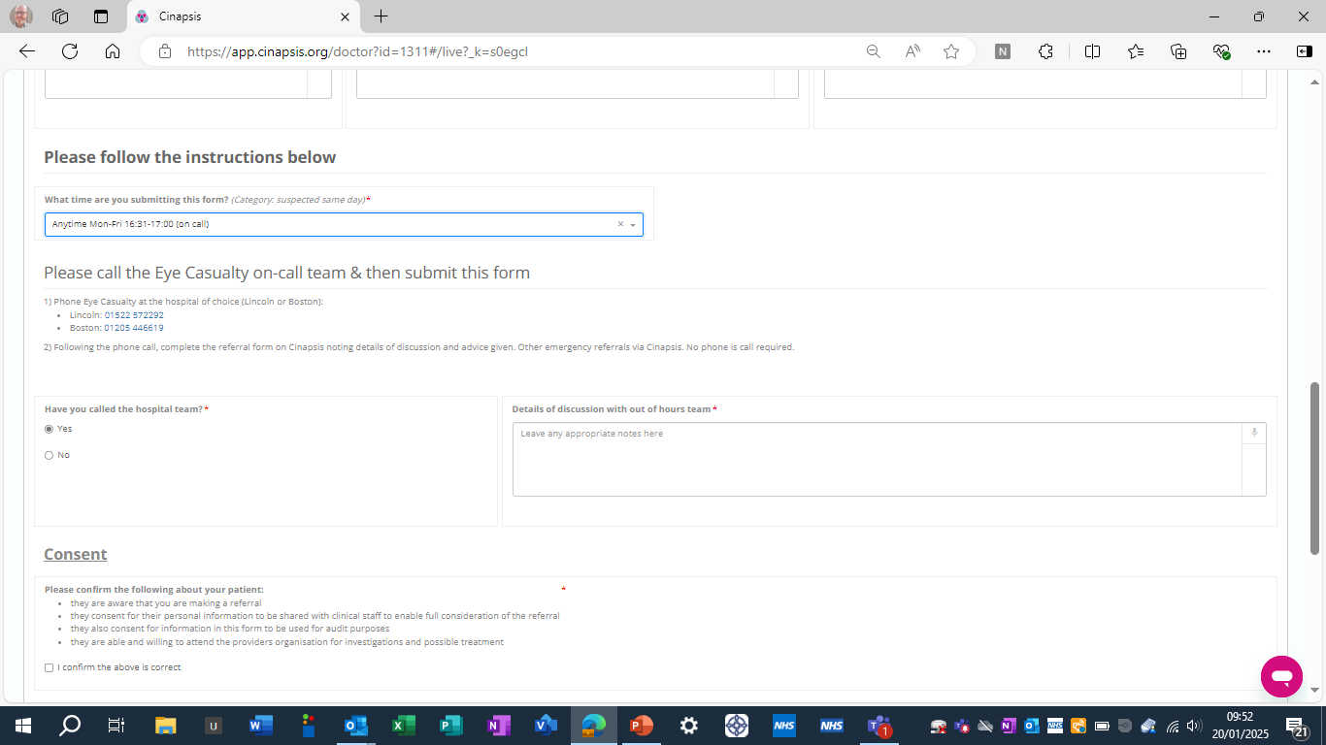
IF BETWEEN 1630 & 1700 PLEASE CALL EYE CASUALTY DIRECT

Slide 11
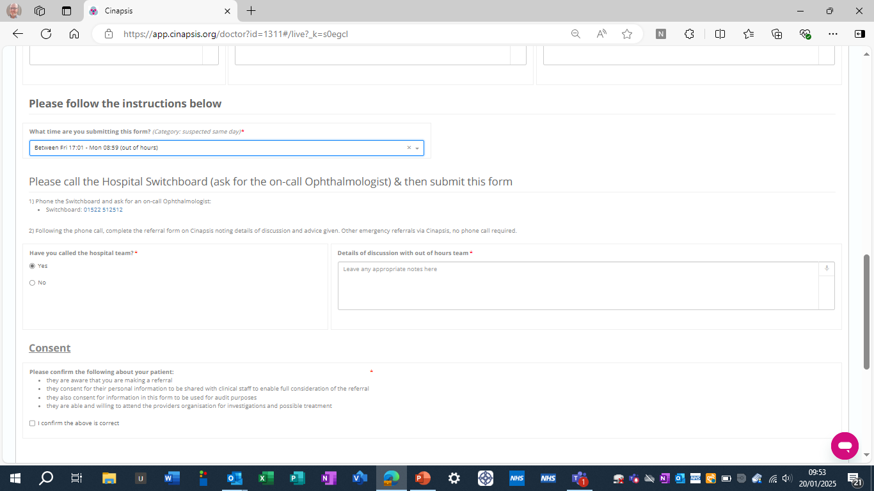
IF AFTER 1700 AND AT WEEKENDS PLEASE CALL OUT OF HOURS ON CALL VIA THE HOSPITAL SWITCHBOARD

Slide 12
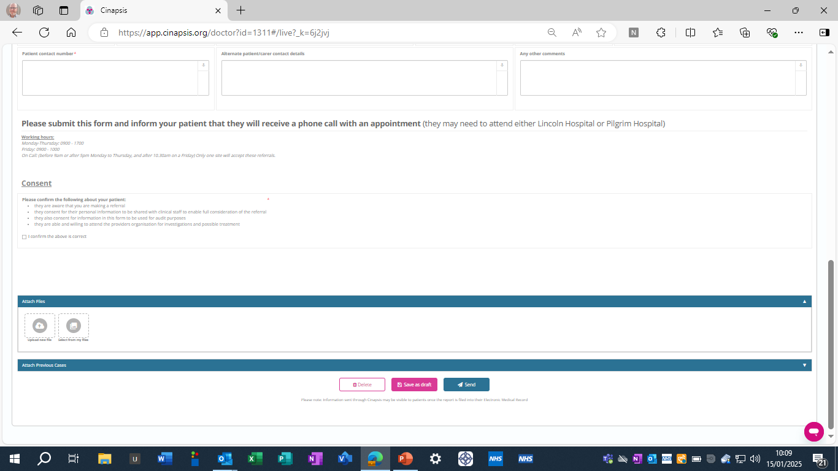
COMPLETE THE REFERRAL – PLEASE TICK CONSENT
ADD ANY IMAGES
COMPLETE REFERRAL BY CLICKING “SEND”

Slide 13
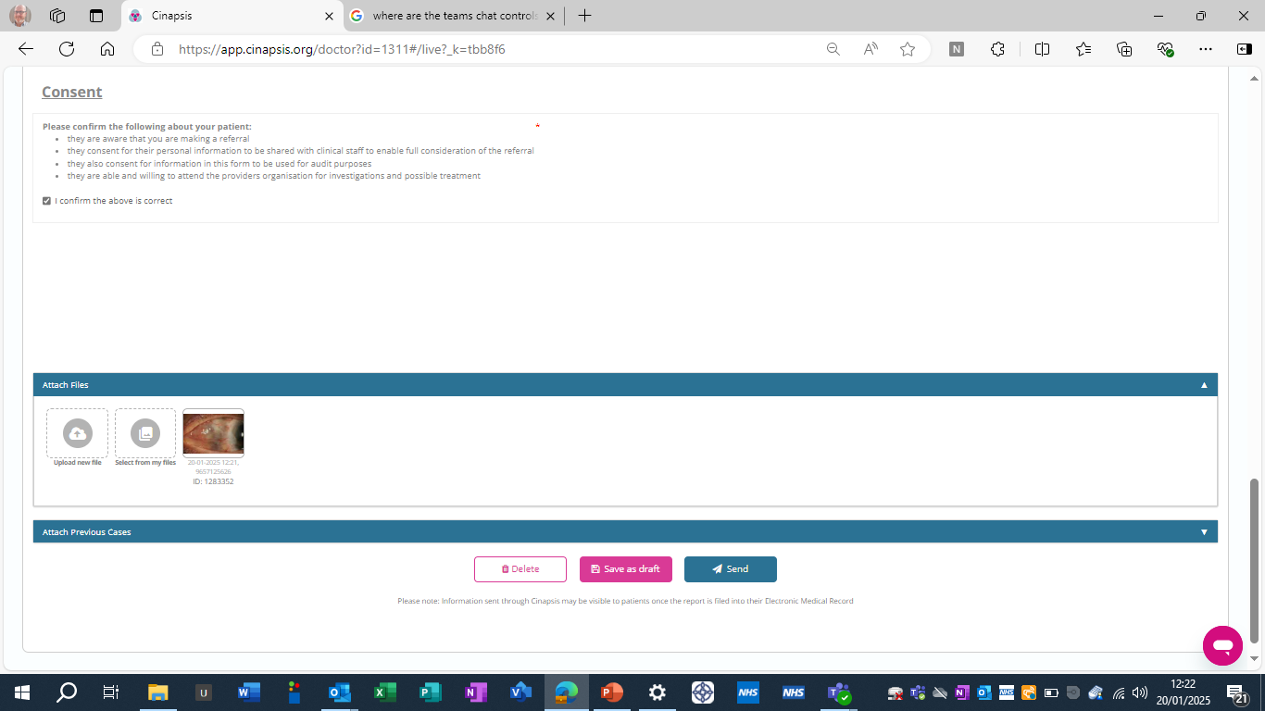
PATIENT CONSENT
ADD ANY IMAGES
TO COMPLETE REFERRAL – CLICK SEND

